Slide 1
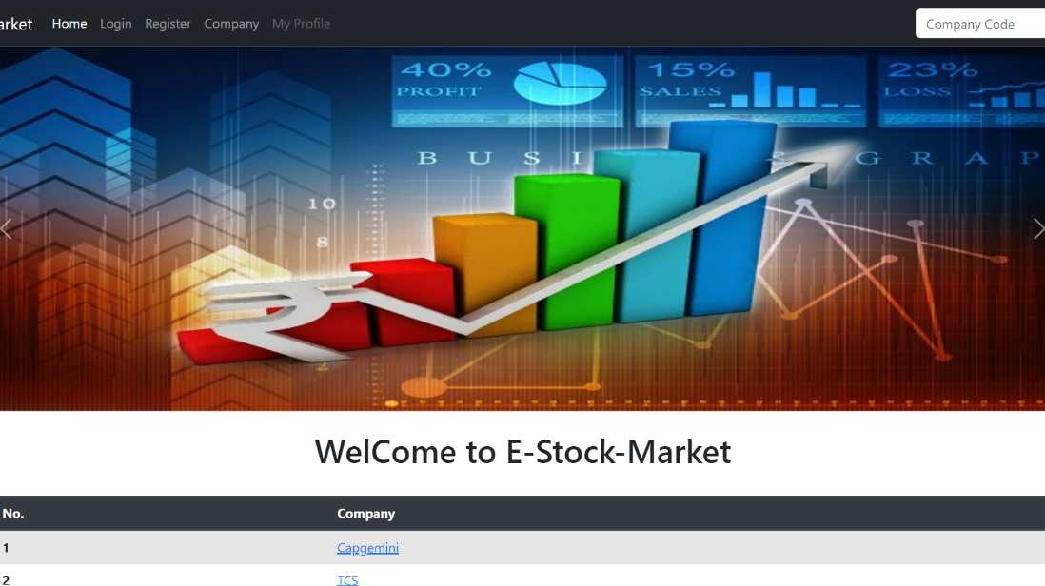
Case Study On E-Stock Market
Presented By :-
Devanshi Joshi
Achal Belpande
Pratiksha Joshi
Sayali Shewale
Akanksha Vibhute

Slide 2

Contents
Intro to stock market
Architecture
Technology Used
Tables
Features

Slide 3

Intro to stock market :-
The Need to invest money :-
Investing ensures present and future financial security.
Where to invest?
Fixed income instruments
Equity (Stock Market)
Real estate
Commodities (precious metals)
What is stock market :-
The stock market is where investors connect to buy and sell investments - most commonly, stocks, which are shares of ownership in a public company.

Slide 4
Architecture:-
Received http request from front end
Ask For Data
SQL
DATABSE
WEB API .NET
ANGULAR
Send the data
Send it to front end
Perform operation on data
AZURE

Slide 5




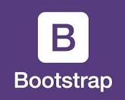

Technology Used :-
Website Hosting Azure
Front-end :- Angular
UI :- Bootstrap , Front Awesome
Back-end :- .NET Web API
Database :- SQL
IDE :- Visual Studio
Source :- code Editor : Visual Studio Code
Browser :-Google Chrome

Slide 6

DB Table Used :-
Company Details
Customer Details
Stock Details
User Data
Login

Slide 7

Features :-
Company and Customer can register and add details.
Company can add stock details.
User can buy share.
Stock and Company details are available.
Company can remove the company details.

Slide 8
Thank You

